Slide 1
eXtreme Programming
Overview

Slide 2
Overview
Motivation behind XP
The need to embrace change
Perceived “cost of change” curve
XP flattens the curve
XP project lifecycle
The 12 XP practices

Slide 3
Motivation behind XP: Problems with existing approaches
Project success is just luck
Integration nightmares
Low sponsor expectations
Smelly software: it’s brittle, wrong features, missing features, buggy…

Slide 4
Agile processes must embrace change
The “Engineering” in “Software Engineering” encouraged adoption of practices from other engineering disciplines
Some considered inappropriate:
  Complete upfront requirements gathering
  Complete upfront design
However, software is meant to be malleable:
  Open to change
  Not constrained by physical laws
  Software systems are difficult to fully understand upfront. Upfront requirements/design usually wrong

Slide 5
Cost of Change Curve
Cost of
change
Time
Assumption that all software exhibits this characteristic
Assumption true if we follow traditional waterfall-style practices or any heavy-weight upfront development
Also true if you don’t adopt a process that adopts change

Slide 6
XP flattens the curve
Cost of
change
Time
Applying XP values flattens the curve:
  Simplicity: apply KISS rigorously
  Communication: XP demands communication
  Feedback: Continual feedback loop with stakeholders
  Courage: To make change without fear

Slide 7
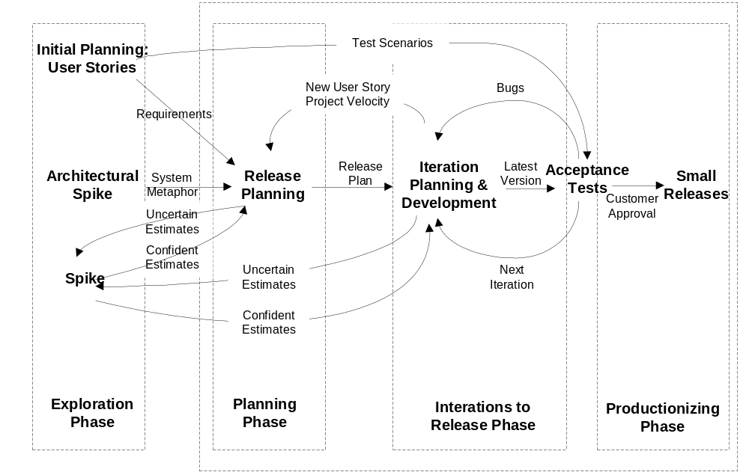
XP project lifecycle
Notes:
Some detail is omitted, e.g. the Initial Planning Game

Slide 8
Practice 1: Planning Game
3: Determines scope
Release dates
Priorities
Order of story development (iteration by iteration)
Customer
1: Stories
(on index cards)
Development
Team
2: Estimate effort for each story
Cost implications of using various technologies
Team organisation
Risk of each story

Slide 9
Practice 2: Test-driven development
Unit testing
  Developers write unit tests first (with some design and stub class development)
  Then they develop just enough code to pass the tests
  End up with comprehensive set of tests
  Tests provide clear documentation of code intent
Acceptance testing
  Customer writes these for each story
  Provide validation
  They are the real requirements
  Applied frequently

Slide 10
Practice 3: Pair programming
Why pair programming?
  Two heads are better than one when designing and coding
  Spreads system knowledge
  Encourages disciplined application of practices, e.g. testing
  Swapping pairs spreads system knowledge even further
  Continual code and design reviewing
  Peer to peer cross training

Slide 11
Practice 4: Merciless refactoring
Improving code without changing its functionality
Aim to write simplest code that will work, e.g. apply abstraction and remove duplication
When do you refactor in XP?
  Before implementing a feature…
  After implementing a feature…

Slide 12
Practice 5: Simple design
XP encourages incremental design
Find simplest design that will solve the problem:
  Leads to code that will run all the tests
  Contains no duplicate code
  States programmers’ intent for code clearly
  Contains fewest possible classes and methods but respects OO principles of high cohesion and low coupling
“You aren’t going to need it” principle (YAGNI)

Slide 13
Practice 6: Collective code ownership
Everybody owns the code
Everybody is responsible for developing and maintaining the code
Everybody is allowed to refactor team code
If you break it you must fix it

Slide 14
Practice 7: Continuous integration
Integrate code in an integration platform several times a day
Possible through the use of suite of unit tests that must be run repeatedly
  Yours prior to integration
  All after integration (regression testing)
Results in continuous bug fixing

Slide 15
Practice 8: On-site customer
To fulfil XP’s communication value
To ensure continuous feedback
Story cards are a commitment to a later conversation
If not on-site, then at least must be readily available

Slide 16
The other four practices
Practice 9: Small releases: providing business value as quickly as possible
Practice 10: 40 hour week: avoid burnout and workforce attrition
Practice 11: Apply “coding” standards: common look-and-feel to project artefacts
Practice 12: System metaphor: Loosely relates to idea of architecture, e.g. shopping trolley and checkout metaphor

